Slide 1

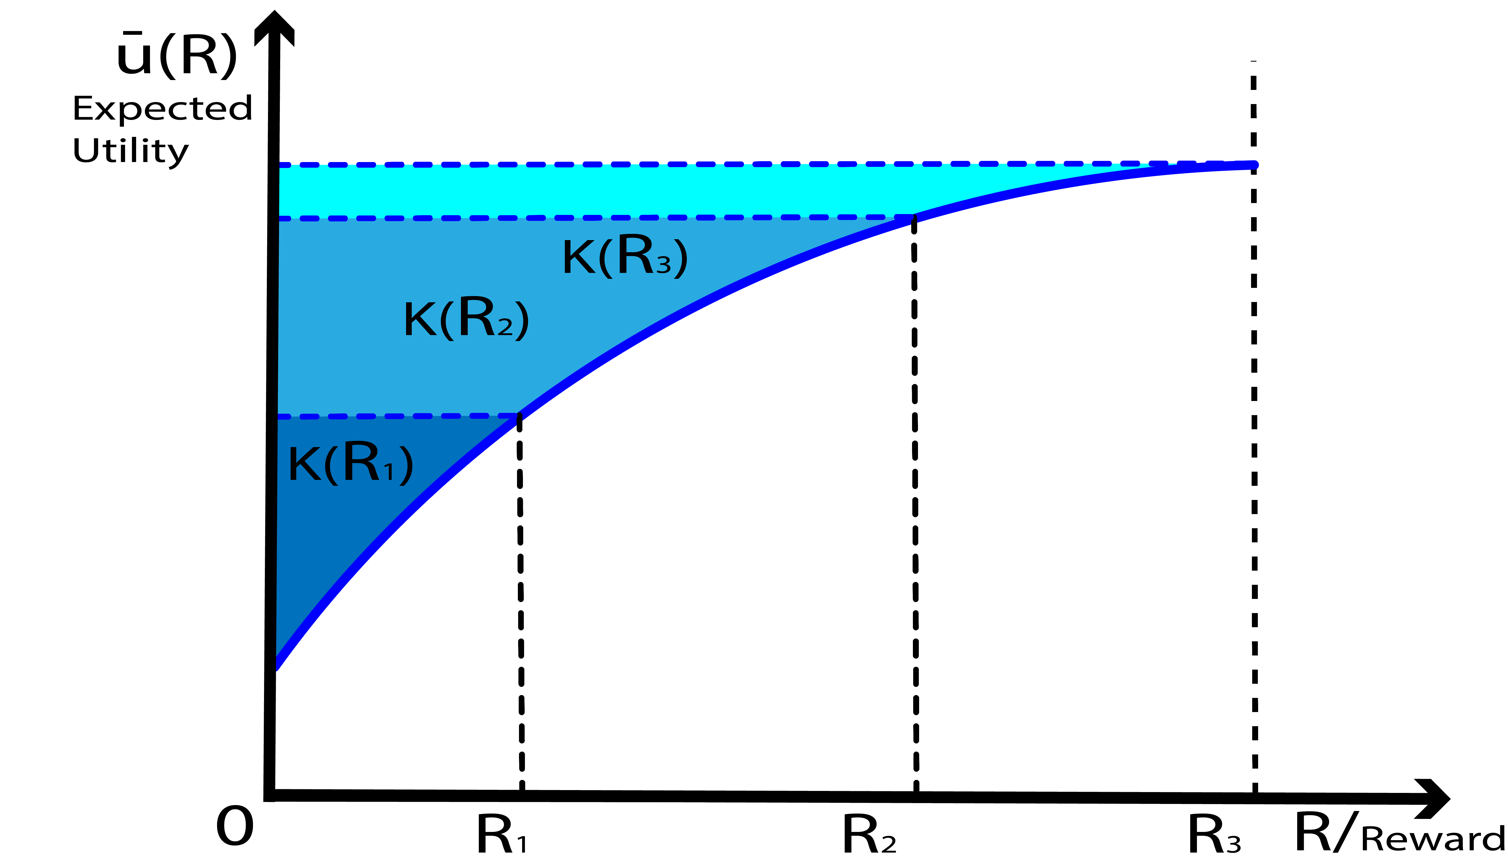
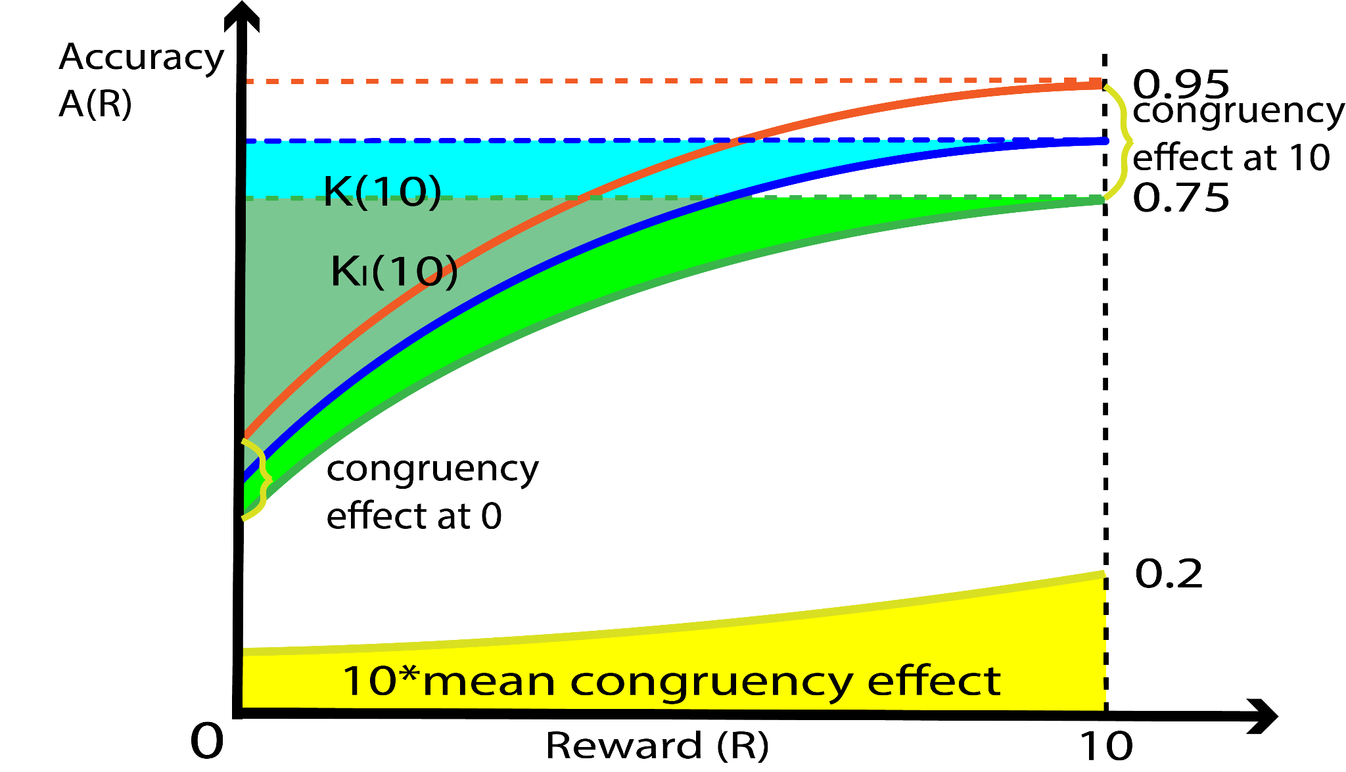
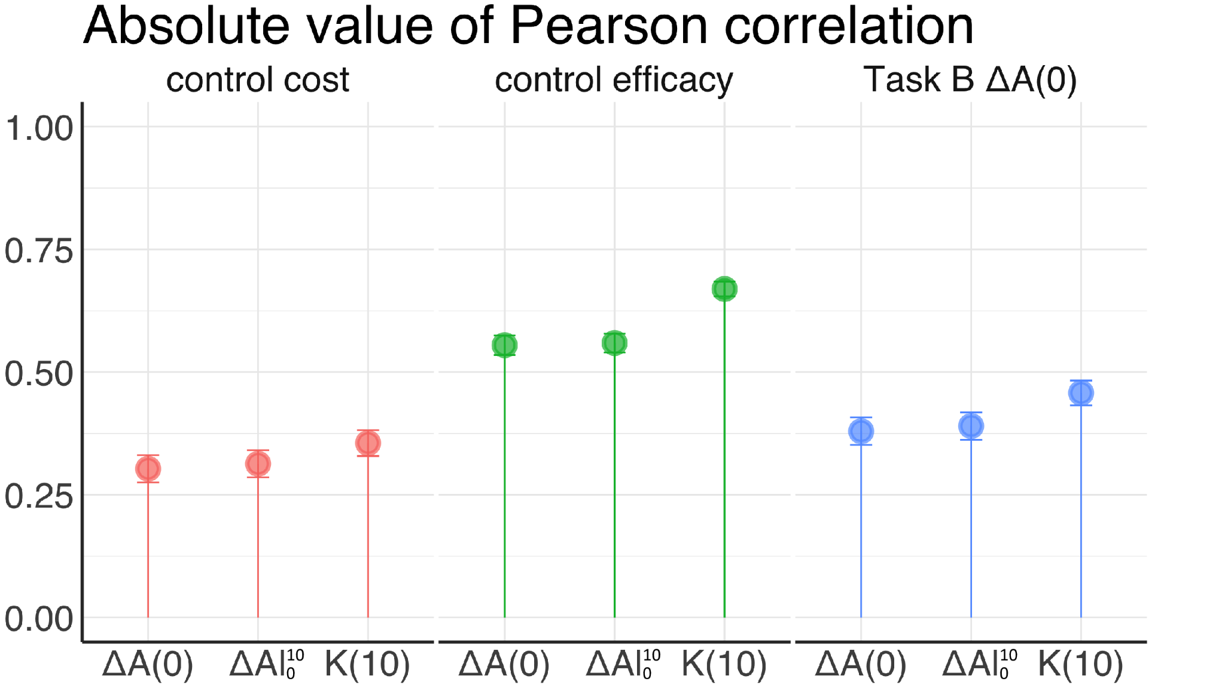

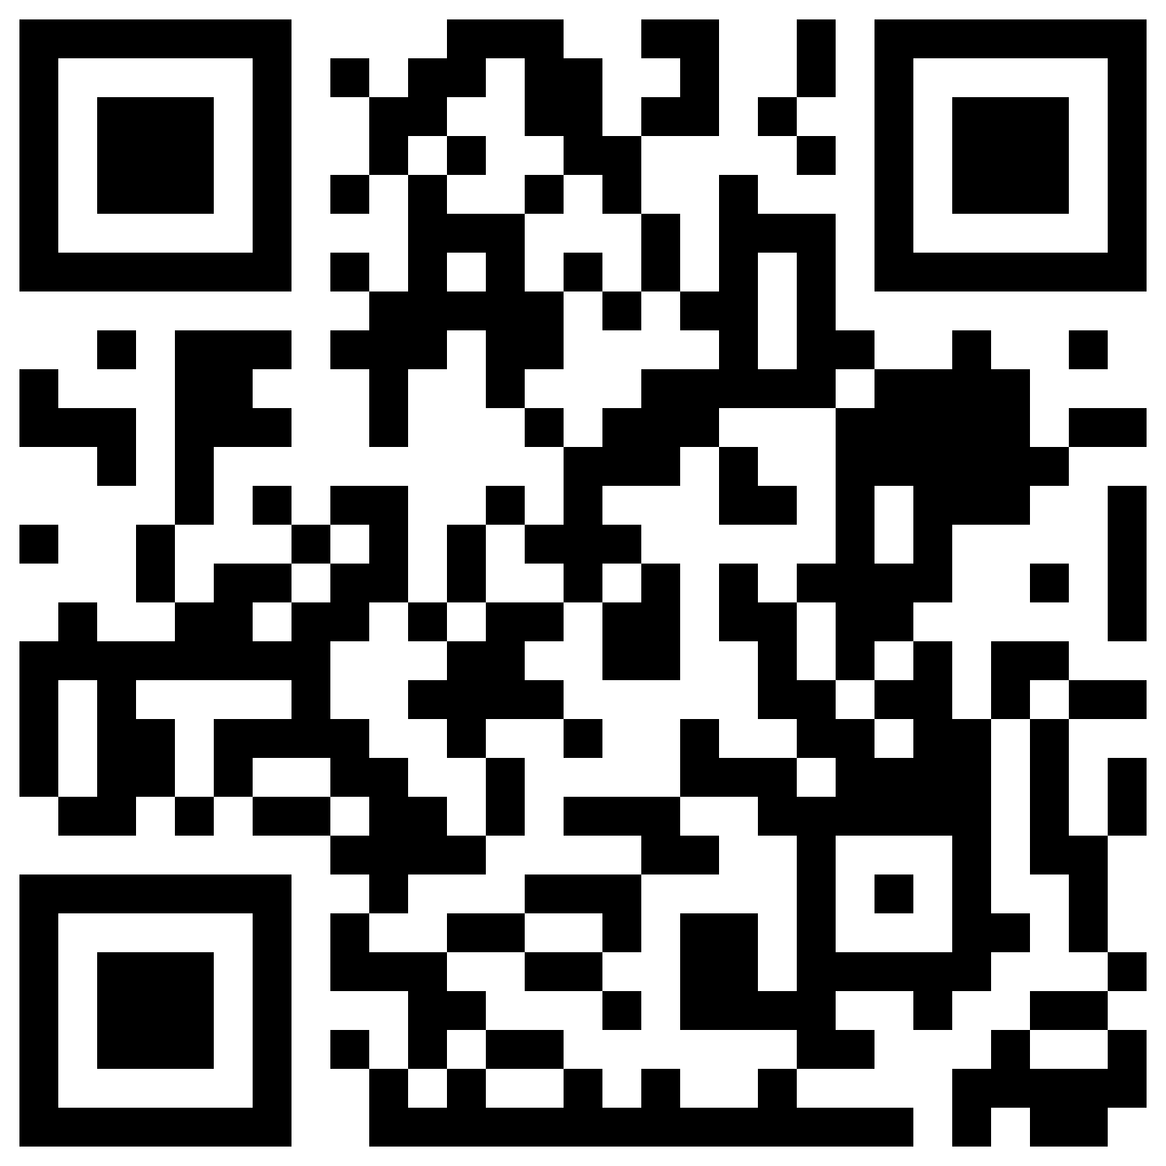
Mean Congruency effect
Background
Estimating the Capacity for Cognitive Control Based on Psychometric Choice Theory
Cognitive Control Capacity: ability to guide information processing in the service of a task while ignoring distractors.
Problem: existing task performance measures of cognitive control capacity are poorly correlated with each other¹.
Hypothesis: these measures are confounded between capacity and willingness of exerting cognitive control².
Example traditional measure: Congruency Effect (difference in accuracy between incongruent and congruent trials)
Incongruent
-
Congruent
Incongruent
-
Congruent
Green
Green
>><>>
>>>>>
Red
Red
<<<<<
<<><<
Methods
Simulate data sets using a well-validated computational model of cognitive control³ where the amount of reward is varied from 0 to 10
Calculate our measure for control capacity (K) and two traditional measures using the simulated data sets
Our Measure⁴
Utility for the task where reward = R
Choice frequency in the task where reward = R
Compare their strength of correlation with the latent model parameters that we varied during simulation: Control Cost and Control Efficacy
Result: our measure (K) correlates the strongest with …
Control Cost: a model parameter capturing how much addition cost is imposed by exerting each additional unit of cognitive control.
Control Efficacy: a model parameter capturing for each additional unit of cognitive control, how much improvement of task performance is achieved.
Performance on a separate task: the congruency effect calculated on a separate set of simulated data which was not used to calculate our candidate measures.
performance on a separate task
Huang Ham (University of Pennsylvania),
Ivan Grahek (Brown University),
Laura A. Bustamante (Princeton University), Nathaniel Daw (Princeton University),
Andrew Caplin (New York University) &
Sebastian Musslick (Brown University)
P. S. Whitehead, G. A. Brewer, and C. Blais. Are cognitive control processes reliable? Journal of experimental psychology: learning, memory, and cognition, 45(5):765, 2019.
S. Musslick, J. D. Cohen, and A. Shenhav. Decomposing individual differences in cognitive control: a model-based approach. In Proceedings of the 41st Annual Meeting of the Cognitive Science Society. Cognitive Science Society, Montreal, CA, pages 2427–2433, 2019.
A. Shenhav, M. M. Botvinick, and J. D. Cohen. The expected value of control: an integrative theory of anterior cingulate cortex function. Neuron, 79(2):217–240, 2013.
A. Caplin, D. Csaba, J. Leahy, and O. Nov. Rational inattention, competitive supply, and psychometrics. The Quarterly Journal of Economics, 135(3):1681–1724, 2020.
Congruency effect
K(10)
Congruency effect
K(10)
Congruency effect
K(10)
PrePrint
Mean Congruency effect
Mean Congruency effect

